Slide 1
Secure Cooperative Sharing of JavaScript, Browser, and Physical Resources
Leo Meyerovich, David Zhu
Benjamin Livshits
UC Berkeley

Slide 2
Web Application Security
lipstick on a pig?

Slide 3
Not Your Mother’s Browser
browser kernels
JIT compilers
partitioned hardware

Slide 4
Mashup Manifesto
sharing requires control
sharing must be natural
sharing must be cheap

Slide 5
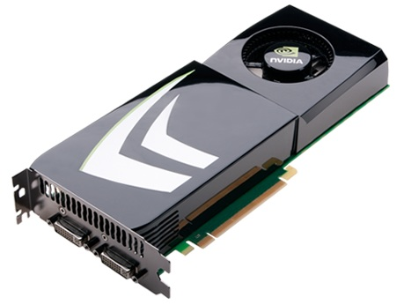
What to Share?
Hardware
disk
Browser APIs
parser, DOM, network, ...
JavaScript

Slide 6
<CoFrame src=http://gadget.com/page id=gadget
passthroughBrowser="html css js"
3. delegatePhysical=".1 cpu"/> ...
4. var toggle = true;
5. delegateBrowser(“network”, gadget, "http://gadget.com",
6. function () { if (toggle) return true; });
7. function getData() {
8. toggle = false;
9. return "profile data"; }
10. aroundJS(gadget, getData,
11. function proceed (continue) { return continue(); });

Slide 7
JS Sharing with Cross-Principal Advice
Alice
Bob
Function.prototype
__proto__
function getData

Slide 8
JS Sharing with Cross-Principal Advice
Alice
Bob
Function.prototype
__proto__
function getData

Slide 9
JS Sharing with Cross-Principal Advice
Alice
Bob
Function.prototype
Messages
execute
set fld val
get fld
addField fld val removeField fld
__proto__
function getData
execute
set, get, …
function proceed (continue) { return continue(); }
function proceed
function defaultDeny
function defaultDeny (continue) { throw ‘err’ }

Slide 10
JS Sharing with Cross-Principal Advice
Alice
Bob
Function.prototype
Messages
execute
set fld val
get fld
addField fld val removeField fld
__proto__
function getData
execute
, get
set, …
function proceed
function defaultDeny

Slide 11
JS Sharing with Cross-Principal Advice
Alice
set, …
Bob
Function.prototype
Messages
execute
set fld val
get fld
addField fld val removeField fld
execute, set, get, addField, removeField
__proto__
function getData
execute
, get
set, …
function proceed
function defaultDeny
Cornelia

Slide 12
Browser API Sharing with Non-Tampering Advice
browser
facebook.com
delegation: non-tampering advice
gadget.com
facebook.com
delegateBrowser(“network”, gadget, "http://gadget.com",
function () { if (toggle) return true; });
parser, DOM, CSS, ...
gadget.com

Slide 13
Physical Resource Sharing with TessellationOS
disk
render
render
render
layout
layout
layout
…
…
…

Slide 14
Mashup Manifesto
sharing requires control
sharing must be natural
control must be cheap

Slide 15
Related Work
JavaScript Sharing Caja
MashupOS
Object Views
ConScript
Browser API Sharing OP Browser
ConScript
ServiceOS
Physical Resource Sharing Resource Containers
E
Gazelle
TessellationOS
Chrome

Slide 16
backup slides.

Slide 18
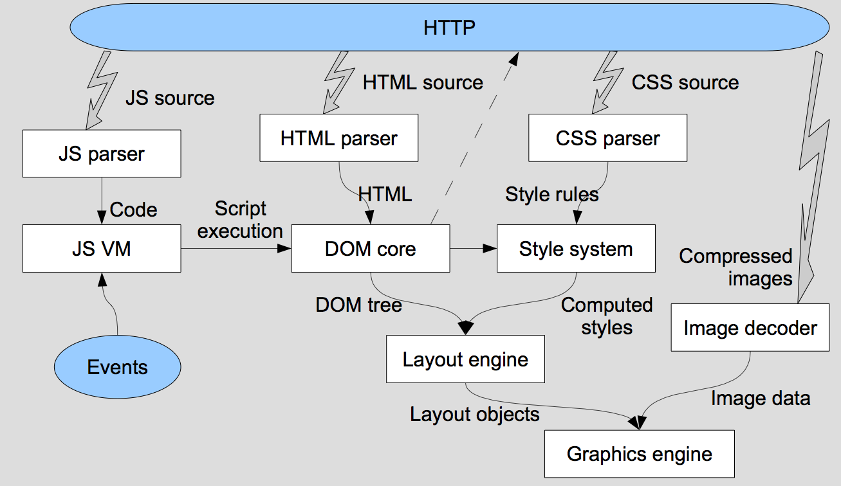
Sharing Browser APIs: Today
Facebook.com
advice
DOM (FFI)

Slide 19
Sharing Browser APIs: Tomorrow
Facebook.com
advice
DOM (FFI)
browser kernel

Slide 20
The Times They Are A-Changin’
method-based JIT
trace-based compilation
static compilation
GPU rendering
solver generator
parallel layout
multicore CSS selectors
parallel parsing
parser generator
browser kernel
browser JIT (C#, X86, …)
hypervisor, microkernel,
hardware partitioning

Slide 21
BROWSER
container.com
gadget.com

Slide 22
gadget
fork bomb!!!
YouTube
policy?
BROWSER
container.com
gadget.com
gadget.com

Slide 23
A New Hope
BROWSER
container.com
gadget.com
gadget.com

